Slide 1
Battle of the Neighborhoods
IBM Data Science Capstone

Slide 2
Introduction
Gurgaon, India, officially named Gurugram, is a city located in the northern Indian state of Haryana
It has become a leading financial and banking center in India after Mumbai and Chennai.
Today, Gurgaon has local offices for more than 250 Fortune 500 companies
Because of the highly diverse community the food industry has booming to extent to satisfy all of its visitors
We are here to find out which locality is the best to stay in, the different types of restaurants present in each locality and we will visualize this data.

Slide 3
Objectives
Which is the best location in Gurgaon city to have South Indian food.
Which areas have the best South Indian Restaurant Market.
Which areas have a less number of restaurants.
Which is the best place to stay if I prefer South Indian cuisine.
What places have the best restaurants in Gurgaon.

Slide 4
Data Used
The data that we will be using in this project will be
All the restaurant data that is present in Gurgaon:
Data source: Zomato Kaggle Dataset
Description : This dataset contain all the details of every restaurant in Gurgaon, we will use this dataset to explore all the localities in Gurgaon.
Nearby places in each Locality in Gurgaon:
Data Source: Foursquare API
Description : Using this API we will get all the venues in each neighborhood.

Slide 5
How to approach the problem
Collect the data from Zomato Kaggle Dataset.
Using the foursquare API, we will find the all the venues for each neighborhood
Filter out all the venues which are nearby each locality.
We will use the aggregative rating for each restaurant to find the best places.
Finally we will visualize the Ranking of the Neighborhoods using the Folium Library.

Slide 6
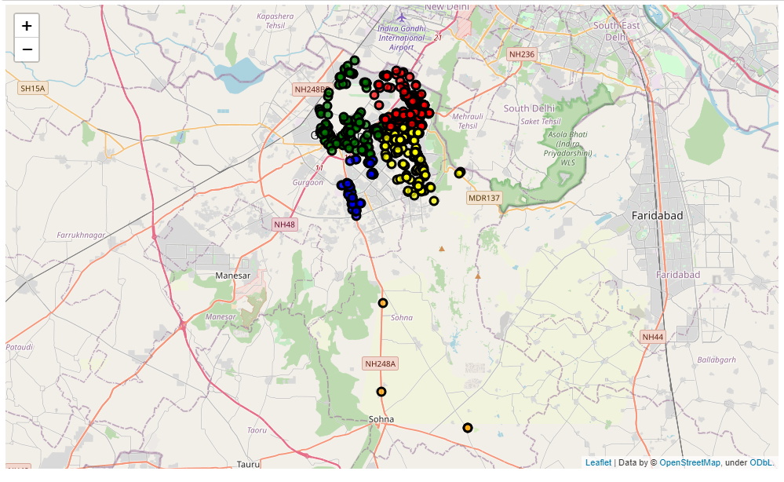
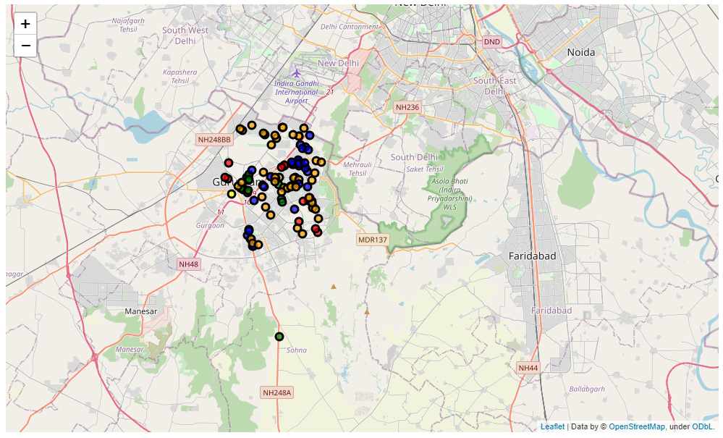
Results (Maps) – Map 1 – Restaurants in Gurgaon Map 2 – Clusters for the Suitable Localities

Slide 7
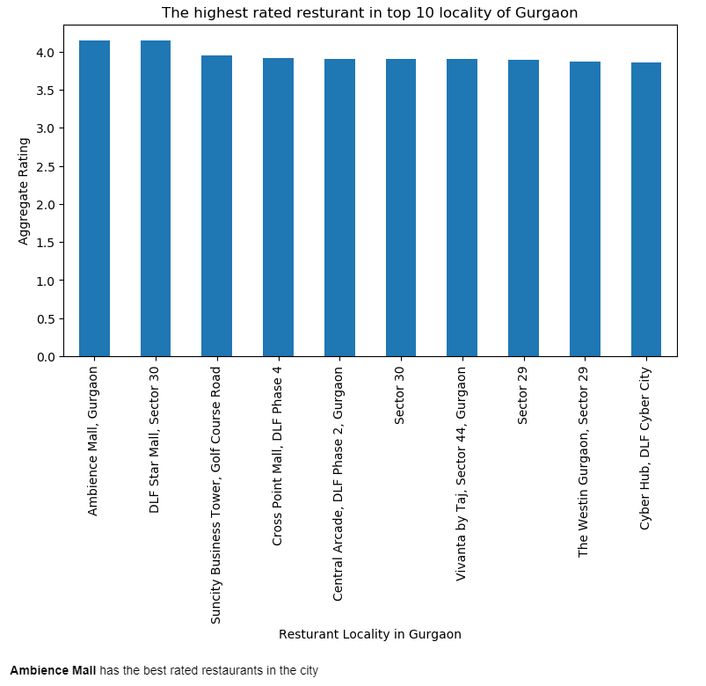
Results - Bar chart 1 Highest Rated Restaurants

Slide 8
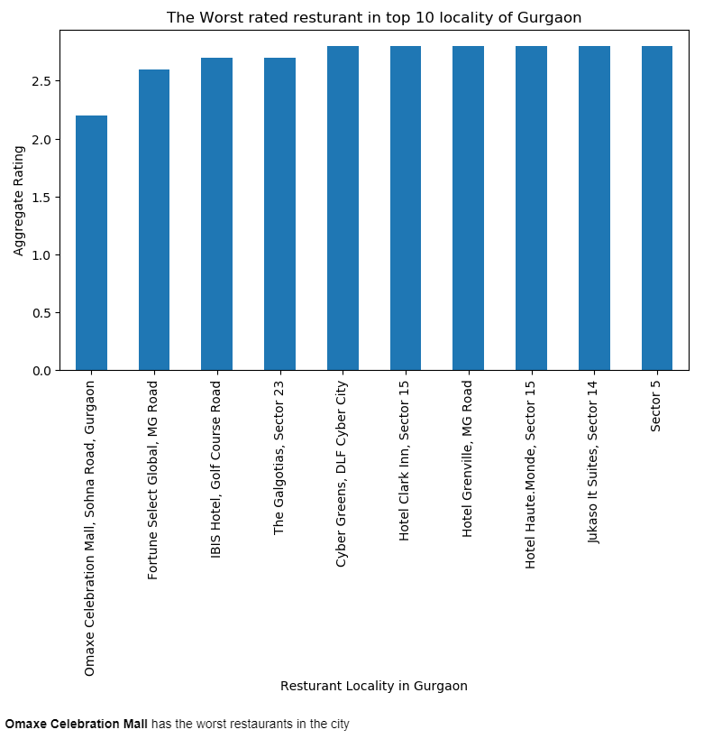
Results - Bar Chart 2 Worst Rated Restaurants

Slide 9
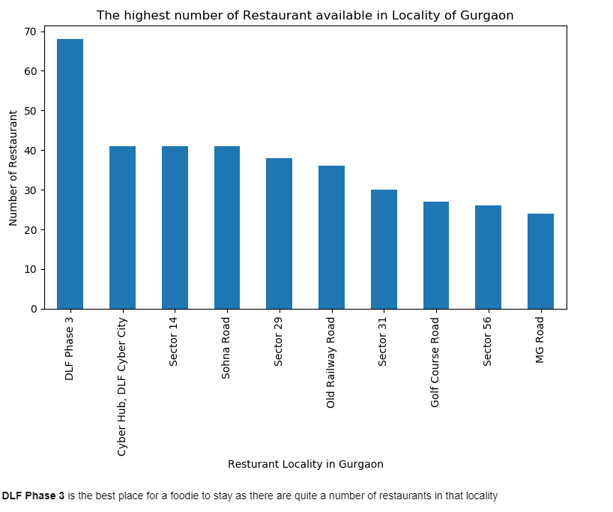
Results - Bar chart 3 Highest No. of Restaurants by Locality

Slide 10
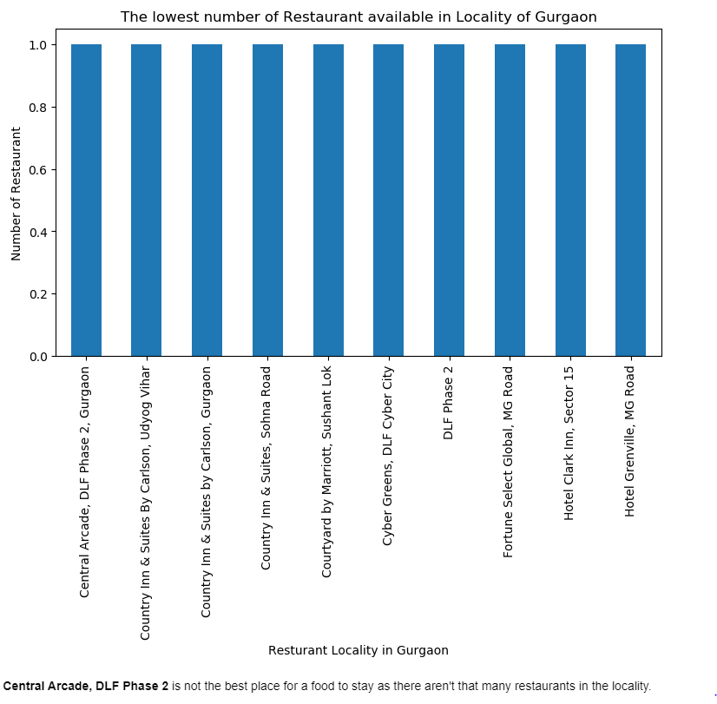
Results - Bar chart 4 Lowest No. of Restaurants by Locality

Slide 11
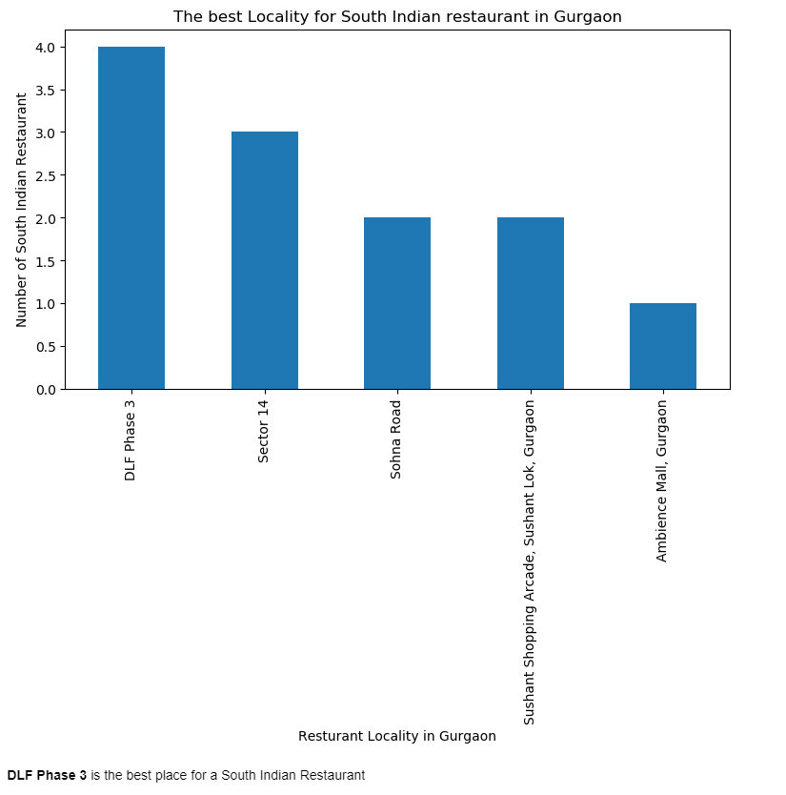
Results - Bar Chart 5 Best Locality to Set Up a South Indian Restaurant

Slide 12
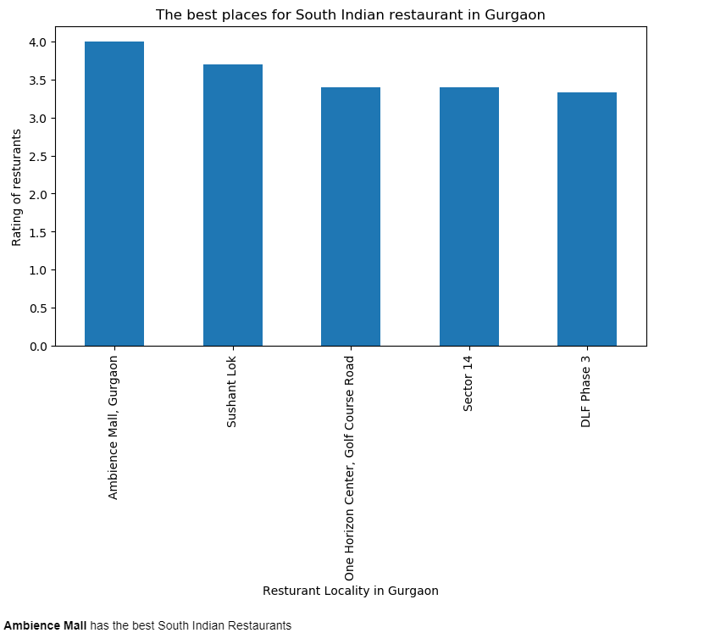
Results - Bar chart 6 Best places with South Indian Restaurants

Slide 13
Conclusion
Conclusion
DLF Phase 3, Sector 14 and Sohna road are the best localities to set up a South Indian Restaurant.
Ambience Mall, Sushant Lok and One Horizon Center, Golf course Road have the best South Indian Restaurants.
DLF Phase 3, Cyber Hub, DLF Cyber City and Sector 14 are the best places for a foodie to stay.
Ambience Mall, DLF Star Mall, Sector 30 and Sun City Business Toer, Golf Course Road have the top rated restaurants.
Cluster 1 is best for Snacks and Fitness Food¶
Cluster 2 is best for Hotels and Bars
Cluster 3 is best for Indian and Fast Food
Cluster 4 is best for Indian Food
Cluster 5 is best for Cafés

